Slide 1
Graduate Follow-up Study
Class of 2011 and 2012
Report for Everett Public Schools Career and Technical Education STEM General Advisory Board
November 14, 2013

Slide 2

Strategic Priorities
District Strategic Plan
1.1.b All students exit with a post-secondary transition plan for work, career and/or college.
5.4.b Each graduate is prepared for transitions to post-secondary education and career choices.

Slide 3
Defining Post-secondary Readiness
Career ready = College ready
Students are eligible, prepared and qualified to earn their first post-secondary credential with value in the marketplace.
Graduates reach a self-sufficiency standard.
100% of graduates are prepared for post-secondary training with no remediation.
Post-secondary training includes
  4-Year College
  2-Year College
  Technical/Vocational College
  Military
  Apprenticeship Programs
Notes:
How do we define post-secondary? Access to a variety of education and training pathways after high school
How do we measure post-secondary readiness?
How are our graduates doing right now?

Slide 4
College Math Placement Test (CMPT)
Prepared for Post-secondary Pathways
Partnership with Everett Community College
Inform students of their college math preparedness
Scores indicate levels of preparedness
  17 = MTH107 (basic college-level course)
  22 = Pre-calculus (STEM field level course)
2011-2012 School Year CMPT Administration
Total Students | Pre-Calculus Qualified | MTH 107 Qualified | Remedial Level
1650 | 508 (31%) | 607 (37%) | 535 (32%)

Slide 5
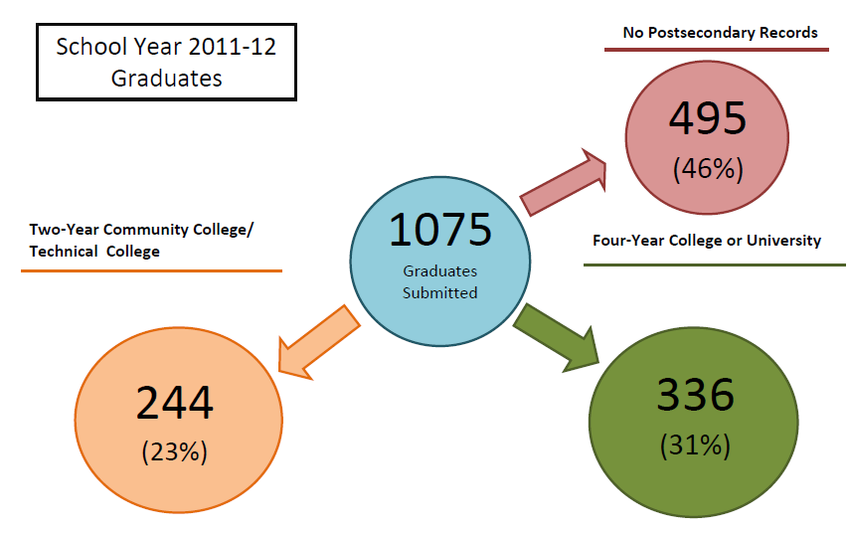
Post-secondary Pathways
Note: The National Student Clearinghouse counts graduates as those graduated during the academic year (9/1 – 8/31) regardless of Federal Graduation Year. Graduates could include early, on-time and extended graduation.
Source: National Student Clearinghouse Student Tracker for High Schools Aggregate Report, Effective Date 2012 0408
Notes:
School year 2012 graduates
Graduates don’t match our number of graduates – FERPA and based on school year
54% enrolled in college fall after graduation

Slide 6
Graduate Follow-up Study
Class of 2011
Post-secondary Pathways
Sample size: 427 graduates surveyed, 80% response rate
Post-secondary Activities
Continuing schooling | 73%
School and work | 29%
Work only | 14%
Military service | 3%
Types of Work
Wholesale and retail | 31%
Restaurant | 20%
Manufacturing | 8%
Source: Decision Research, Everett School District Graduate Follow-up Study: Class of 2011
Notes:
Graduate Follow-up study is another resource
Class of 2011
Sample size – 342 – 34%
Gives more information about working after high school
Percentages are not supposed to add up to 100%

Slide 7
Graduate Follow-up Study
Class of 2011
Post-secondary Pathways: Student Planning
Career and college planning services participation
Class selection and plans of study | 54%
Career exploration and planning | 30%
Job and college applications | 43%
Financial aid and scholarships | 46%
When asked “Could you have used more assistance from a counselor/advisor?” 82% reported “Yes.”
Financial Aid/Scholarships (56%)
Job/Career Exploration (53%)
College/Job Applications (47%)
Course Selection (30%)
Personal Problems (15%)
Source: Decision Research, Everett School District Graduate Follow-up Study: Class of 2011
Notes:
Study also asks questions about career and college planning
Numbers do not add up to 100%, multiple questions
82% of graduates reported they could have used more assistance

Slide 8
Graduate Follow-up Study Class of 2012
Post-secondary Activities
Continuing education | 69%
School and work | 29%
Work only | 19%
Military service | 4%
Post-secondary Education
4 Year College or University | 49%
Community College | 44%
Trade or Technical School | 4%
Types of Work
Wholesale and retail | 21%
Restaurant | 27%
Service Industry | 11%
Health Care | 7%
Source: Decision Research, Everett School District Graduate Follow-up Study: Class of 2012
Sample size: 438 graduates surveyed, 76% response rate
Notes:
Graduate Follow-up study is another resource
Class of 2011
Sample size – 342 – 34%
Gives more information about working after high school
Percentages are not supposed to add up to 100%

Slide 9
Graduate Follow-up Study
Class of 2012
Post-secondary Pathways: Student Planning
Career and college planning services participation
Class selection and plans of study | 66%
Career exploration and planning | 29%
Job and college applications | 42%
Financial aid and scholarships | 48%
When asked “Could you have used more assistance from a counselor/advisor?”
Financial Aid/Scholarships (48%)
Job/Career Exploration (29%)
College/Job Applications (42%)
Course Selection (66%)
Personal Problems (28%)
Source: Decision Research, Everett School District Graduate Follow-up Study: Class of 2012
Notes:
Study also asks questions about career and college planning
Numbers do not add up to 100%, multiple questions
82% of graduates reported they could have used more assistance

Slide 10
Career Clusters and Courses Taken
2012-2013
Number of students enrolled for 2012 - 2013 school year
Career Cluster | Courses | CHS |  | EHS |  | JHS |  | SHS |  | Totals
 |  | 1st Sem | 2nd Sem | 1st Sem | 2nd Sem | 1st Sem | 2nd Sem | 1st Sem | 2nd Sem
Agriculture and Natural Resources | AP Environmental Science | 19 | 17 |  |  |  |  |  |  | 36
 | Floriculuture I, II, III & IV |  |  | 107 | 106 |  |  |  |  | 213
STEM | Environmental Systems Design | 80 | 73 | 30 | 27 | 59 | 29 |  |  | 298
 | Tech Foundations / Coordinated Science | 395 | 417 | 362 | 362 | 441 | 428 | 44 | 44 | 2493
 | Physics by Design | 140 | 129 | 87 | 79 | 114 | 111 | 14 | 8 | 682
 | Introduction to Science Research and Engineering |  |  |  |  | 21 | 20 |  |  | 41
Arts, Audio Visual Technoolgy and Communications | AP Studio Art |  |  |  |  | 10 | 26 |  |  | 36
 | Digital Photography I, II | 94 | 95 | 123 | 122 | 168 | 168 |  |  | 770
 | Graphic Design I, II, III | 29 | 29 |  |  | 48 | 80 |  |  | 186
 | Intro to Graphic Design |  |  |  |  | 28 | 0 |  |  | 28
 | Publications (Yearbook) I, II | 20 | 25 |  |  | 23 | 23 | 14 | 10 | 115
 | Video Productions I, II, III | 43 | 42 |  |  |  |  |  |  | 85
Government and Public Administration | Naval Junior Reserves Officer Training Corps |  |  | 102 | 102 |  |  |  |  | 204
Business Management and Administration | Workbase Learning | 11 | 21.6 | 9.05 | 31.9 | 28 | 24.7 | 5 | 8.2 | 139
 | Career Choices | 52 | 50 | 63 | 58 | 44 | 14 | 19 | 19 | 319
 | Senior Seminar (CE) |  |  | 93 | 23 | 135 | 69 |  |  | 320
Finance | Accounting | 24 | 0 | 28 | 0 | 0 | 29 |  |  | 81
 | Economics |  |  |  |  | 31 | 0 |  |  | 31
Health Sciences | Family Health | 246 | 236 | 215 | 231 | 213 | 212 |  |  | 1353
 | Intro to Sports Med | 60 | 26 |  |  | 93 | 31 |  |  | 210
 | Sports Med I, II | 0 | 0 |  |  | 0 | 23 |  |  | 23
 | Anatomy and Physilogy | 57 | 55 |  |  |  |  |  |  | 112
 | Nutrition I, II | 156 | 153 | 151 | 118 | 61 | 84 | 15 | 16 | 754
 | Child Development | 60 | 60 | 29 | 50 | 32 | 31 | 11 | 18 | 291
 | Independent Living | 0 | 30 | 26 | 0 | 55 | 49 | 2 | 3 | 165
Computer Science / Information Technology | Computer Applications | 56 | 54 | 30 | 31 | 30 | 0 | 8 | 39 | 248
 | Computer Programming I | 27 | 21 | 0 | 0 | 61 | 25 |  |  | 134
 | UW IT Com Sci Engineering |  |  | 0 | 0 | 0 | 29 |  |  | 29
 | Video Game Design | 0 | 12 | 0 | 0 | 0 | 41 |  |  | 53
 | Web Design | 30 | 0 | 30 | 0 | 27 | 0 |  |  | 87
Law, Public Safety and Security | Business Law |  |  | 0 | 24 | 0 | 19 |  |  | 43
Marketing Sales and Service | Adv Marketing | 9 | 0 | 0 | 0 | 13 | 0 |  |  | 22
 | Fashion Merchandise | 0 | 6 | 0 | 0 | 46 | 18 |  |  | 70
 | Intro to Marketing | 62 | 52 | 61 | 85 | 58 | 53 |  |  | 371
 | School Store | 16 | 17 | 24 | 28 | 29 | 34 |  |  | 148
 | Sports/Ent Marketing | 0 | 0 | 0 | 0 | 0 | 31 |  |  | 31
Transportation, Distribution and Logic | Auto Maintenance | 46 | 21 |  |  |  |  |  |  | 67
 | Auto Technology | 41 | 92 |  |  |  |  |  |  | 133
 | Totals | 1773 | 1733.6 | 1570.05 | 1477.9 | 1868 | 1701.7 | 132 | 165.2 | 10421.45

Slide 11
Career Clusters and Courses Taken
2012-2013
Notes:
Carl
There are 13 Career Clusters from the 16 identified that we have courses
Every Career and Technical Education class falls into one of 16 “career clusters.” A career cluster is a group of jobs and industries that are related by skills or products. Within each cluster, there are cluster “pathways” that correspond to a collection of courses and training opportunities to prepare one for a given career.
Ag Science (3)
Business Mngt and Admin (1)
Education and Training (2)
Human Services (6)
Law, Public Safety and Security (1)
Marketing Sales and Service (5)
STEM (5)
Health Sciences (6)
Arts, Audio Video Technology and Communications (5)
Information Technology (8)
Transportation Distribution and Logistics (5)
Worksite Learning Experience (2)

Slide 12
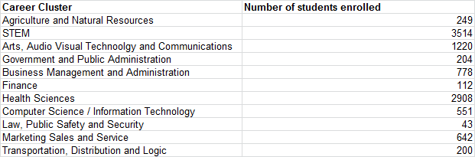
Career Cluster Enrollment 2012-2013

Slide 13
Completer Report
(Students completing 360 hours of sequenced Career and Technical Education classes.)
Career Clusters | 2012-2013 | 2011-2012
Video Communications, Publications | 32 | 37
Agriculture and Natural Resources | 3 | 3
Government and Public Administration | 41 | 0
Health Sciences | 66 | 19
Human Services | 0 | 33
Information Technology | 2 | 20
Science, Technology Engineering & Math | 365 | 6
Transportation Logistics and Distribution (Auto) | 17 | 24
Business, Marketing, Finance and Economics | 29 | 44
Education and Training | 0 | 93
Total | 555 | 279

Slide 14
Completer Report
(Students completing 360 hours of sequenced Career and Technical Education classes.)

Slide 15
Class of 2013 Graduates
816 Earned Tech Prep Credit
(Must have earned a B or better for college credit)

Slide 16
Industry Certifications
2012-2013 school year 481 Everett Public Schools students earned industry certifications.
13 National Automotive Skills Standards Association (Automotive Technology courses)
130 Microsoft IT (Office User Specialist courses in the following areas: word (48), PowerPoint (57), Access (1), and Excel (22).
13 STARS (Day care Aide).
325 National Career Readiness Certification (NCRC); Platinum 2, Gold 112, Silver 168, and Bronze 43.
2011-2012 school year 146 Everett Public Schools students earning industry certifications.
26 National Automotive Skills Standards Association (Automotive Technology courses)
45 Microsoft IT (Computer Applications and Office User Specialist courses)
16 STARS (Day care Aide)
59 National Career Readiness Certification(NCRC) that was a field test in the spring and will be implemented into all CE courses this coming year

Slide 17
Industry Certification

Slide 18
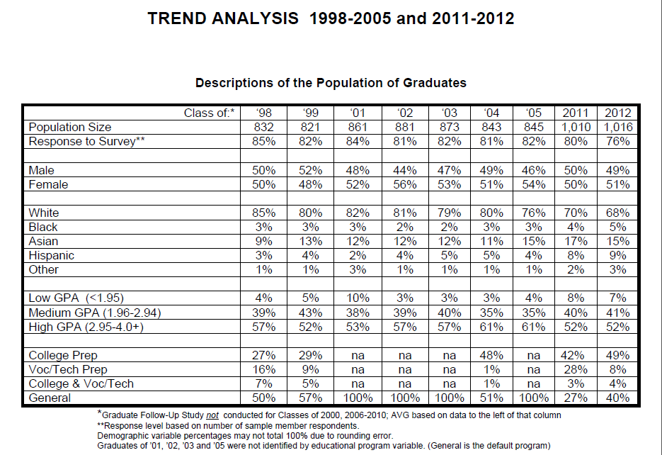

Slide 19
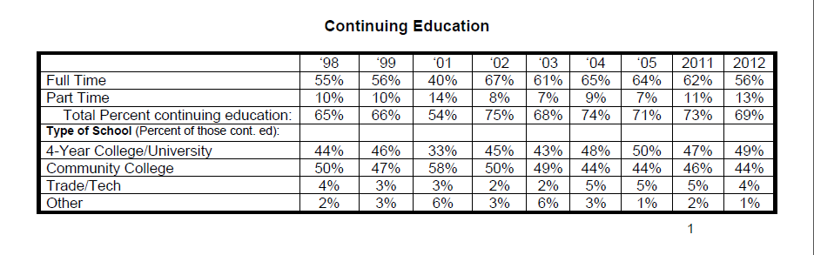
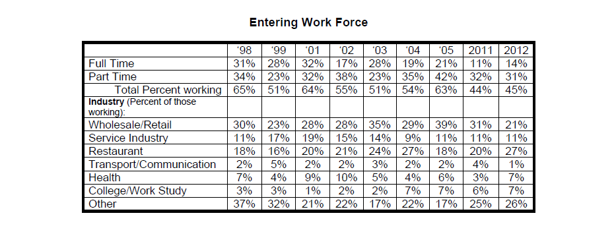

Slide 20
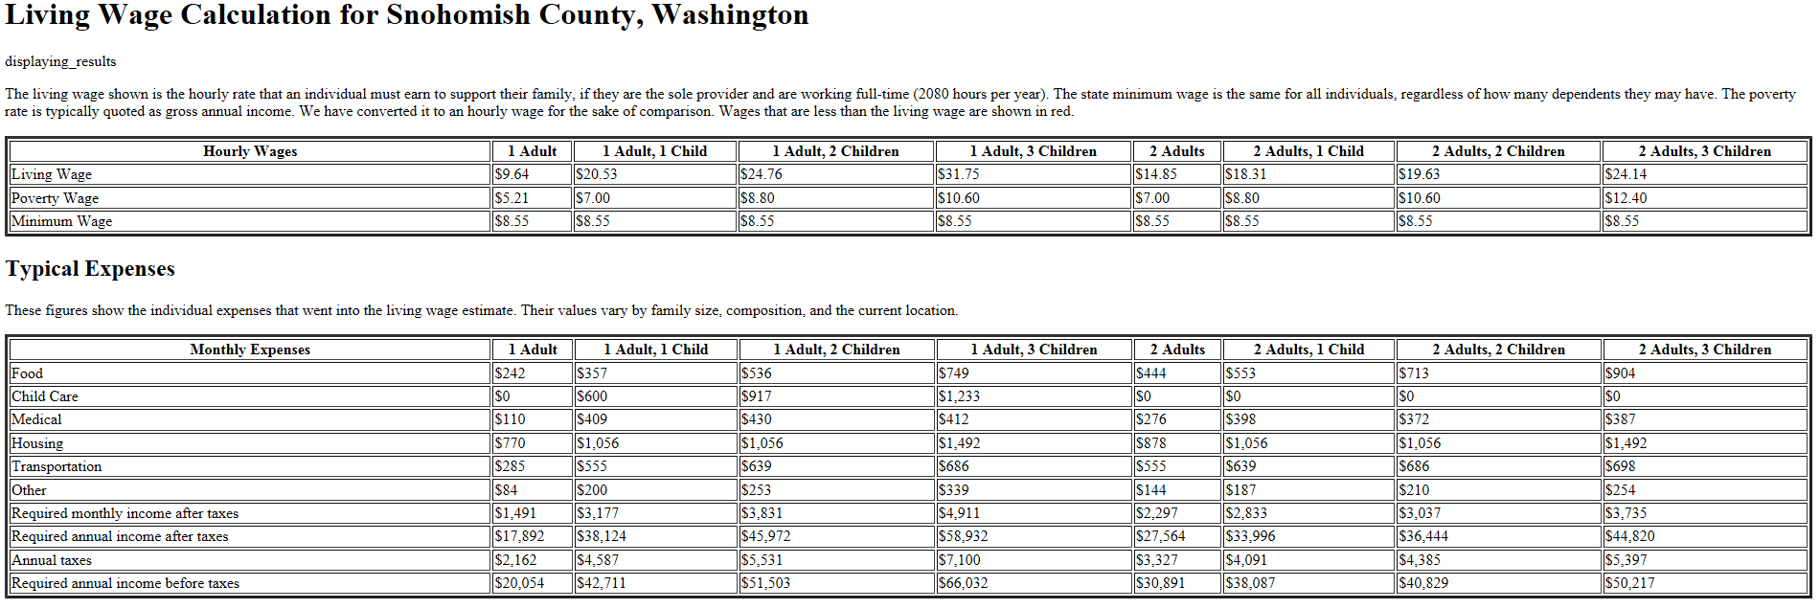

Slide 21
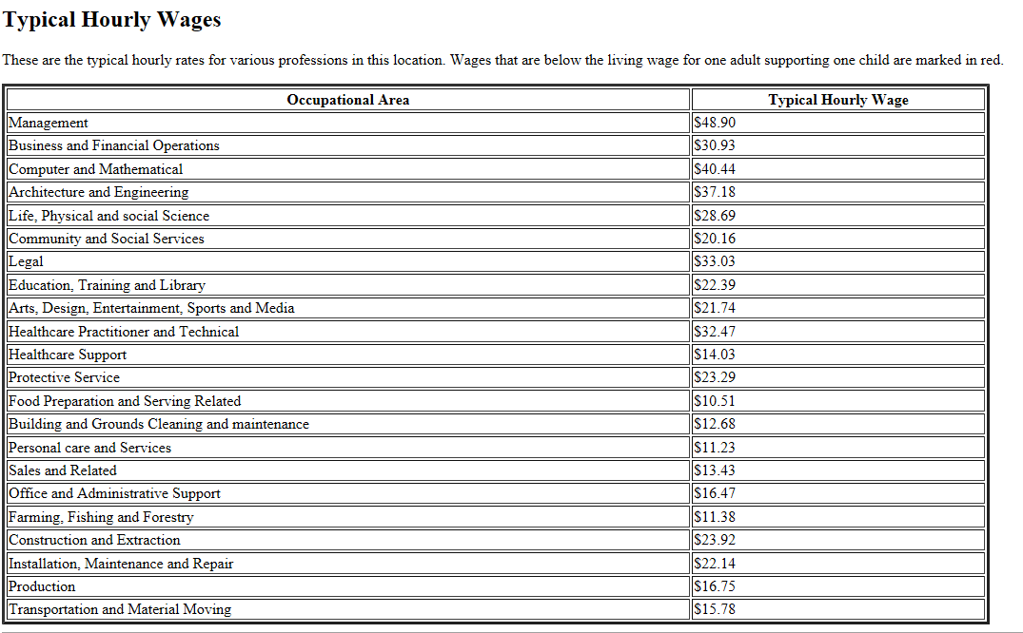
Source: http://livingwage.mit.edu/

Slide 22
Post-secondary Training: Pathways to Self-Sufficiency
Apprenticeship Choices
Examples in Snohomish County
Apprenticeships include a combination of work and classroom experience
Occupation | Average Annual Wage | Estimated Weekly Earnings* | Predicted Average Growth Rate (2014-2019) | Academic Entry Requirements | Length of Apprenticeship
Automotive Mechanic | $37,315 | $718 | .3% | HS diploma or GED | 2-4 years
Electrical Worker | $66,442 | $1,273 | 1% | HS diploma or GED; equivalent of 1 year HS algebra with C or higher | 1-4 years
Iron Worker | $46,251 | $889 | 2.5% | HS diploma or GED | 3-4 years, journey level exam
Machinist | $45,330 | $872 | 1.2% | HS diploma or GED | 2-5 years
Operating Engineers | $53,476 | $1,028 | 2.7% | HS diploma or GED; 2 years vocational training | 3-4 years
Pipefitter/ Plumber | $58,009 | $1,116 | 1.2% | HS diploma or GED; equivalent of 1 year each HS algebra and geometry | 2-5 years
Average Growth Rates range from -3.1% (log graders and scalers) to 7.5% (biomedical engineers).
* Estimated weekly earnings calculated by dividing the average annual wage by 52 weeks.
Sources: Washington State Employment Security Department Workforce Explorer, Numbers and Trends report for Snohomish County (https://fortress.wa.gov/esd/lmea/countydashboard/Default.aspx?area=53_04_000061); Washington State Labor Department and Labor of Industries, Apprenticeship Programs in Washington State (http://www.lni.wa.gov/TradesLicensing/Apprenticeship/Programs/default.asp)
Notes:
Some examples of specialized skill jobs in Snohomish county.
Jobs I hear about when people talk about jobs available after high school.
All are accessed through additional training like apprenticeship programs.
Application process is competitive, students still need a plan.

Slide 23
Thank You

Slide 24

Questions?

